Slide 1


Sascha Höche
06.06.2023

Slide 2

Outline
Executive Summary
Introduction
Methodology
Results
Conclusion
Appendix

Slide 3
Executive Summary
In this project, the following methodologies were used
For data collection, web scraping as well as APIs were used
An exploratory data analysis (EDA) was performed, that included data wrangling and visualization
Predictive analysis using machine learning tools was performed
Summary of all results
All public sources delivered workable data
The features that allowed the best prediction of successful launches have been determined during EDA
The best model to predict the important characteristics of a successful launch have been determined via the machine learning phase.

Slide 4
Introduction
Project context
Determine the viability of a hypothetical company “Space Y” to compete with the existing company “Space X”
Research Questions
What are the best predictors for a successful launch, thereby minimizing the costs?
What launch location is the most desirable?

Slide 5

Section 1

Slide 6
Methodology
Executive Summary
Data collection methodology:
Space X launch data was obtained from two sources:
Space X official API (https://api.spacexdata.com/v4/rockets/)
Web Scraping Falcon 9 Wiki Page (https://en.wikipedia.org/wiki/Falcon/_9/_and_Falcon_Heavy_launches/)
Perform data wrangling
Summarizing and analyzing features as well as creating a landing outcome label as a result
Perform exploratory data analysis (EDA) using visualization and SQL

Slide 7
Methodology
Executive Summary
Perform interactive visual analytics using Folium and Plotly Dash:
Perform predictive analysis using classification models
Normalizing data
Performing a test/train 20/80 split
Evaluating four classification

Slide 8
Data Collection
Data was collected via an API call to https://api.spacexdata.com/v4/rockets/
Secondary data was collected via WebScraping with BeautifulSoup4 on https://en.wikipedia.org/wiki/Falcon/_9/_and_Falcon_Heavy_launches/

Slide 9
Data Collection – SpaceX API
Using the official Space X Rest API
Github URL: DS_Capstone_Project/notebook_SpaceX_Data_Collection_a7gpUg3Rl.ipynb at main · saschahoeche/DS_Capstone_Project · GitHub
Request to REST API for Space X launch data
Filter for Falcon 9 data only
Replacing missing values with mean

Slide 10
Data Collection - Scraping
WebScraping the falcon 9 wiki page with Beautiful Soup module
Github Url: DS_Capstone_Project/notebook_SpaceX_Webscraping_9tL4IJnwd.ipynb at main · saschahoeche/DS_Capstone_Project · GitHub
Request Falcon 9 launch wiki page
Extract rows with HTML search in BS4
Parsing HTML data into a pd Dataframe

Slide 11
Data Wrangling
EDA including visualizations were performed
The positive outcomes were calculated for each type of orbit
The outcomes were translated into a Outcome column
Github Url: DS_Capstone_Project/notebook_SpaceX_Data_Wrangling_GcebiAJvN.ipynb at main · saschahoeche/DS_Capstone_Project · GitHub
EDA and Vis
Summation per Orbit
Outcome as column

Slide 12
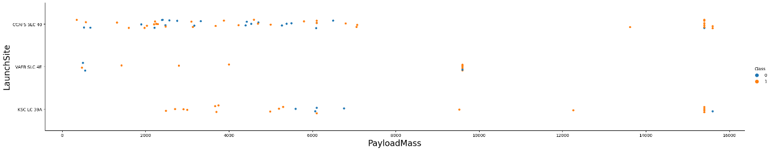
EDA with Data Visualization
To visualize relationships between pairs of features, scatterplots and barplots were used
Github Url:DS_Capstone_Project/notebook_SpaceX_EDL_with_Vis_dOEPS91SK.ipynb at main · saschahoeche/DS_Capstone_Project · GitHub

Slide 13
EDA with SQL
SQL Queries performed:
Select unique launch sites
Top 5 launch sites beginning with ‘CCA’
Total payload mass carried
Average payload mass carried by booster F9 v1.1
Date of first successful landing pad landing
Booster names with successful drone ship landing and 4k to 6k payload
Number of successful and not successful missions
Count of landing outcomes between 04.06.2010 and 20.03.2017
Github Url: DS_Capstone_Project/notebook_SpaceX_EDL_with_SQL_0KH9YtJM3.ipynb at main · saschahoeche/DS_Capstone_Project · GitHub

Slide 14
Build an Interactive Map with Folium
Markers, circles, lines and clusters were created
Markers to indicate launch sites
Circles to highlight areas around those launch sites
Clusters of markers to group events by coordinates
Lines as distance measure between coordinates
Github Url: DS_Capstone_Project/notebook_SpaceX_Interactive_Dashboard_L5vVtXuSg.ipynb at main · saschahoeche/DS_Capstone_Project · GitHub

Slide 15
Build a Dashboard with Plotly Dash
Visualized data with following features
Percentage of launches per site
Payload range
This allowed a quick overview of the relations between launch sites and payloads and helped identifying where best to launch depending on the payload
Github Url: DS_Capstone_Project/notebook_SpaceX_Interactive_Dashboard_L5vVtXuSg.ipynb at main · saschahoeche/DS_Capstone_Project · GitHub

Slide 16
Predictive Analysis (Classification)
Four classification models were compared:
Logistic Regression
Support Vector Machine
Decision Tree
K – nearest neighbour
Github Url: DS_Capstone_Project/notebook_Machine_Learning_Prediction_Part_5.ipynb at main · saschahoeche/DS_Capstone_Project · GitHub
Data preparation
Test of each model
Result comparison

Slide 17
Results
Exploratory data analysis results
Four different launch sites are used
The average payload of Falcon 9 v1.1 is 2928kg
First successful landing was in 2015
Many above average payload Falcon 9 landed ob drone ships
Landing outcomes improved over the years significantly
Most launches happened on the east coast of the US

Slide 18
Results
The thorough testing of different classification algorhythms showed that the Decision Tree Classifier was the most efficient to predict successful landings with an accuracy of 87%

Slide 19

Section 2

Slide 20
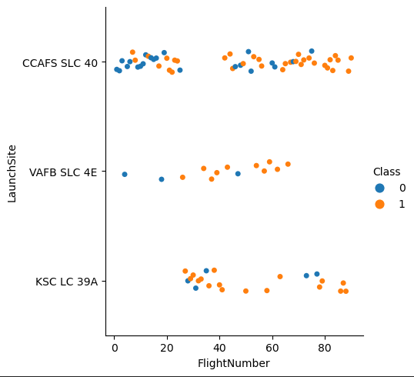
Flight Number vs. Launch Site
The best launch site for recent launches is CCAFS SLC 40
The number of successful launches increased over time

Slide 21
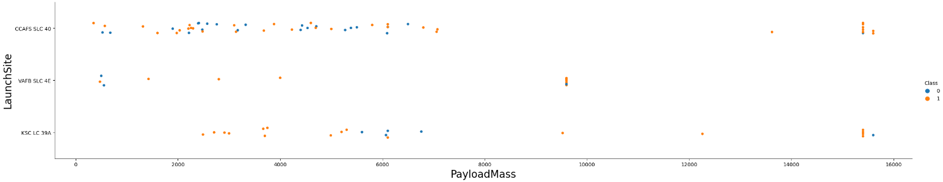
Payload vs. Launch Site
Payloads over 9000kg have the highest success rate
Payloads over 12000kg have only be performed on CCAFS SLC 40 and KSC LC 39A

Slide 22
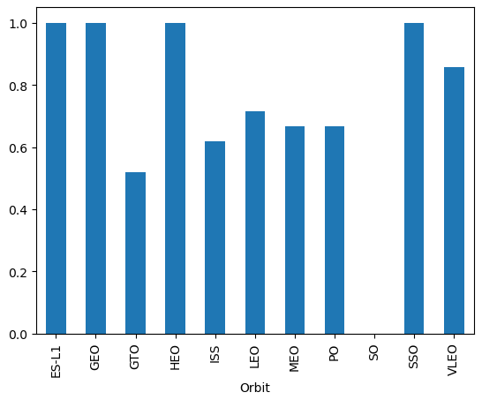
Success Rate vs. Orbit Type
ES-L1, GEO, HEO and SSO have been launched without failure

Slide 23
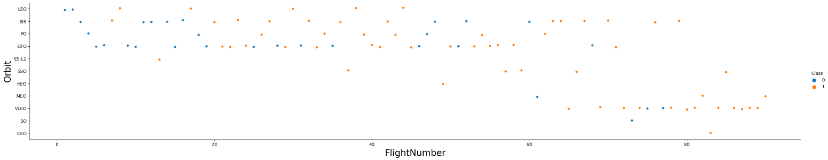
Flight Number vs. Orbit Type
Success rate improved over time with all Orbit types
Launches into VLEO orbit have increased recently

Slide 24
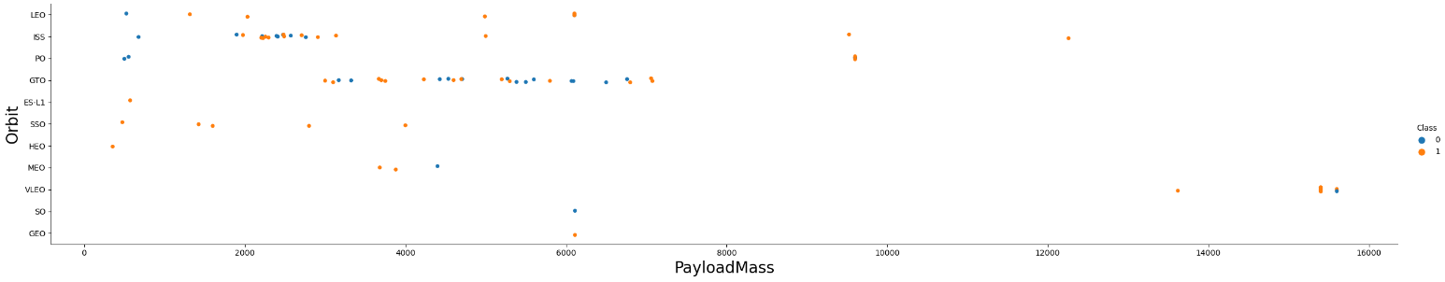
Payload vs. Orbit Type
No relationship between payload and GTO orbit success rate
Launches to ISS orbit have the highest range of payloads with reasonably high success rates
SO and GEO orbits are used the least

Slide 25
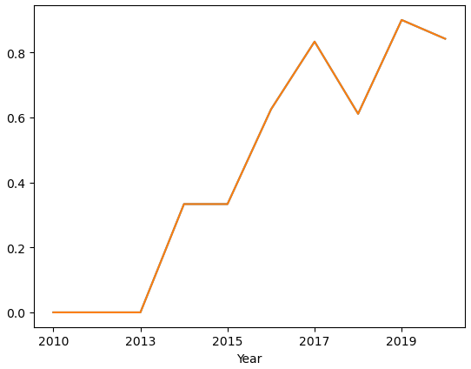
Launch Success Yearly Trend
Steadily increasing launch success rate
No successes during the first three years

Slide 26
All Launch Site Names
There are four launch sites:
These have been extracted from the “launch_sites” value in the dataset
Launch Sites
CCAFS LC 40
CCAFS SLC 40
KSC LC 39A
VAFB SLC 4E

Slide 27
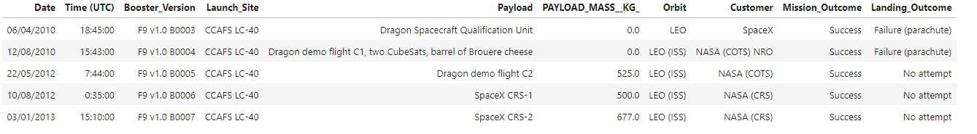
Launch Site Names Begin with 'CCA'
Five records of launch sites that begin with `CCA`
CCA stands for Cape Canaveral

Slide 28
Total Payload Mass
Tpayload carried by boosters from NASA
The sum of all payloads containing the code ‘CRS’
Total Payload (kg)
111268

Slide 29
Average Payload Mass by F9 v1.1
Average payload mass carried by booster version F9 v1.1
Data filtered by booster version and then averaged
Average Payload (kg)
2928

Slide 30
First Successful Ground Landing Date
First successful landing outcome on ground pad
Filtering the data for the first successful landing on a ground pad returned above date
Min Date
2015-12-22

Slide 31
Successful Drone Ship Landing with Payload between 4000 and 6000
Boosters which have successfully landed on drone ship and had payload mass greater than 4000 but less than 6000
Filtering booster data according to above limitations
Booster Version
F9 FT B1021.2
F9 FT B1031.2
F9 FT B1022
F9 FT B1026

Slide 32
Total Number of Successful and Failure Mission Outcomes
Calculate the total number of successful and failure mission outcomes
Grouping mission outcomes by counts for each group
Mission Outcome | Occurrences
Success | 99
Success (payload status unclear) | 1
Failure (in flight) | 1

Slide 33
Boosters Carried Maximum Payload
Booster which have carried the maximum payload mass
The listed boosters have carried the maximum payload amount in the dataset
Booster Version
F9 B5 B1048.4
F9 B5 B1048.5
F9 B5 B1049.4
F9 B5 B1049.5
F9 B5 B1049.7
F9 B5 B1051.3
F9 B5 B1051.4
F9 B5 B1051.6
F9 B5 B1056.4
F9 B5 B1058.3
F9 B5 B1060.2
F9 B5 B1060.3

Slide 34
2015 Launch Records
Failed landing_outcomes in drone ship, their booster versions, and launch site names for in year 2015
Only two drone ship landings failed in 2015
Booster Version | Launch Site
F9 v1.1 B1012 | CCAFS LC 40
F9 v1.1 B1015 | CCAFS LC 40

Slide 35
Rank Landing Outcomes Between 2010-06-04 and 2017-03-20
Rank all outcomes between 2010-06-04 and 2017-03-20:
Data shows that most attempts have been aborted in the above time frame
Landing Outcome | Occurrences
No attempt | 10
Failure (drone ship) | 5
Success (drone ship) | 5
Controlled (ocean) | 3
Success (ground pad) | 3
Failure (parachute) | 2
Uncontrolled (ocean) | 2
Precluded (drone ship) | 1

Slide 36

Section 3

Slide 37
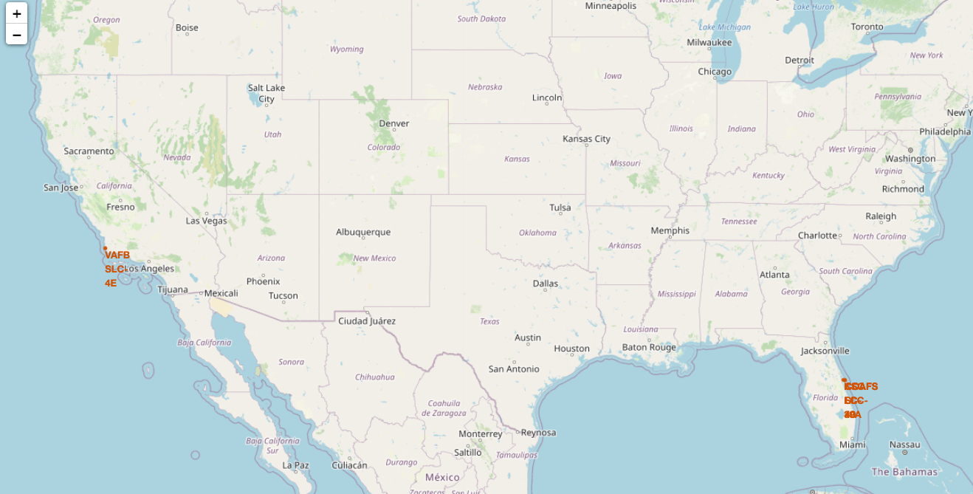
Launch Sites
Launch Sites are usually located near the ocean for safety reasons

Slide 38
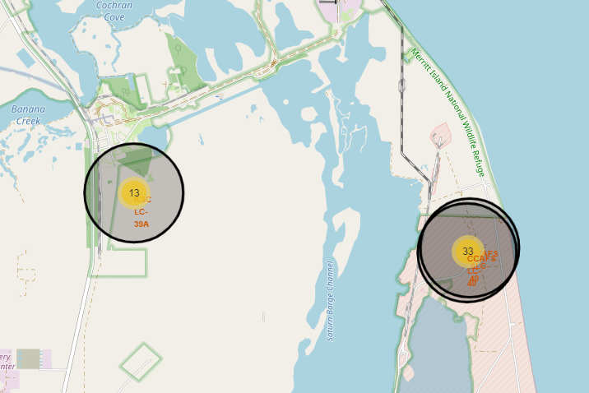
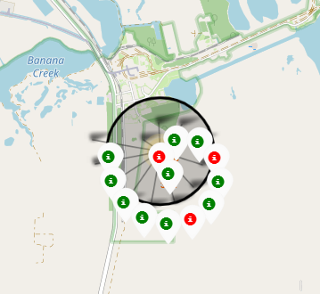
Launch Outcomes
Example launch outcomes for KSC LC 39A, red = failure, green = success

Slide 39
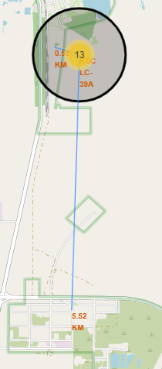
Logistics and Safety
As displayed KSC LC 39A is 0.55km close to the next rail connection for easy transport
And it is 5.52km away from the next urban area for safety and noise reasons

Slide 40

Section 4

Slide 41
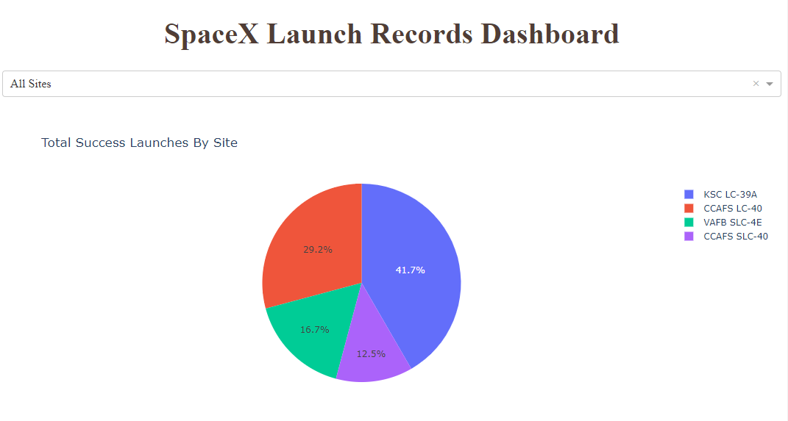
Successful Launches by Site
Identifying the most successful launch sites

Slide 42
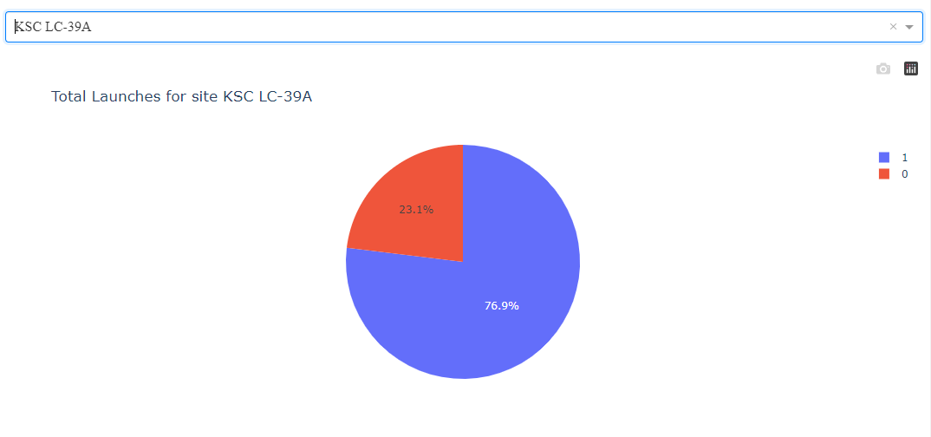
<Dashboard Screenshot 2>
Three quarters of the launches at KSC LC 39A are successful

Slide 43
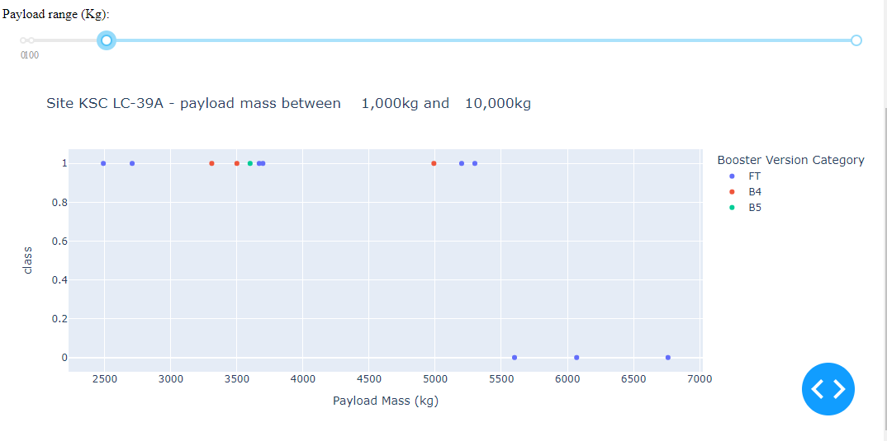
Payload vs. Launch Outcome
Payloads under 6000kg ant FT boosters are the most successful

Slide 44

Section 5

Slide 45
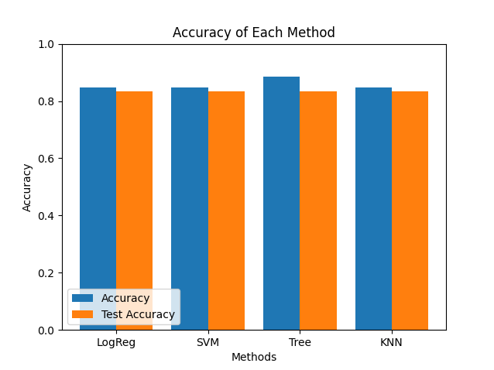
Classification Accuracy
Four classification models were tested
Decision tree classifier has the highest accuracy with 87%

Slide 46
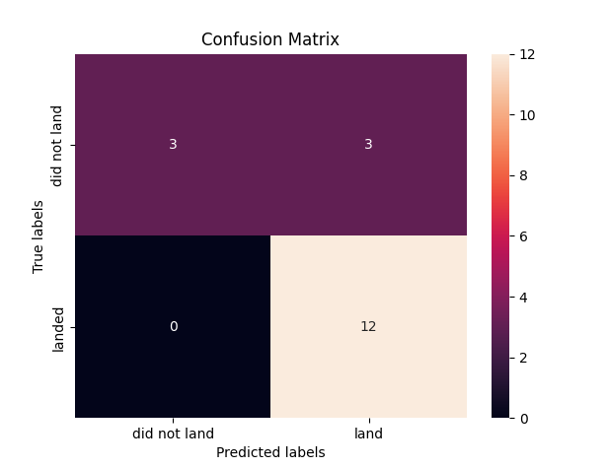
Confusion Matrix Decision Tree
Decision Tree Classifier shows the highest number of true positives

Slide 47
Conclusions
Two data sources were analyzed, both public
The best launch site is KSC LC 39A
Launches over 7000kg have less chance of failure
The majority of missions are successful
The percentage of successful landings increased over time due to improvements in rocket design
Decision Tree classifier can predict a successful landing with 87% accuracy

Slide 48


